Slide 1
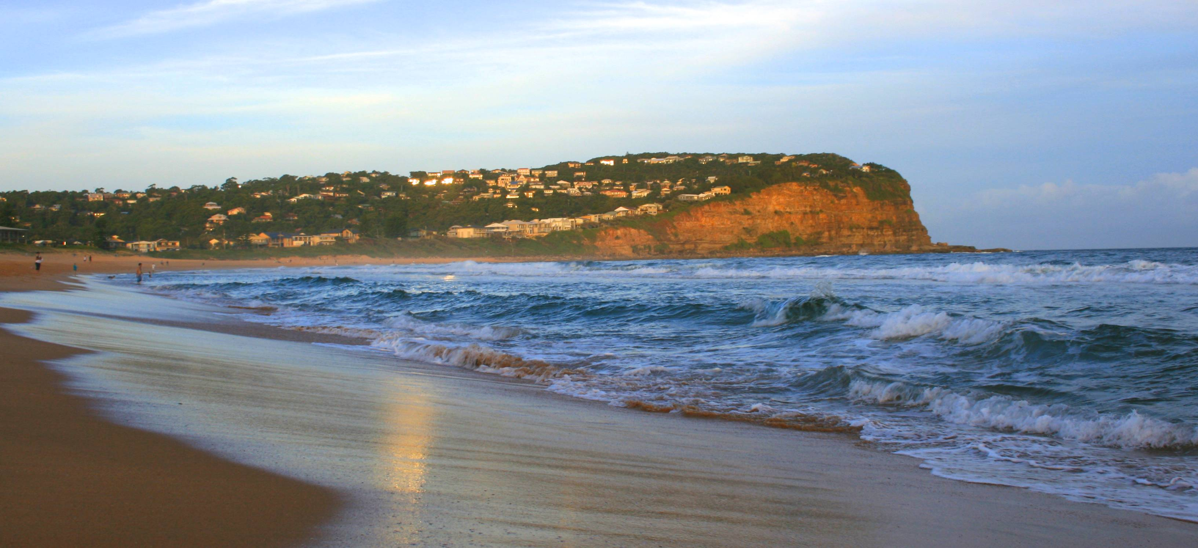
Welcome to Copacabana Public School Headstart 2023
Photo of Copacabana
Notes:
We would like to welcome everyone to view this short presentation. Due to the unusual circumstances we find ourselves in, we have been forced to move our traditional face-to-face headstart presentation on-line. We hope you find the following information useful and supportive as you navigate your way through those first weeks of starting school with your children.

Slide 2
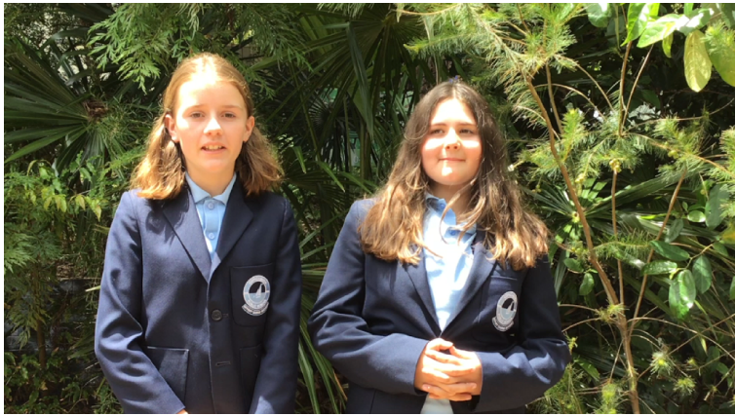
Kinder Orientation
Parent Information Session
Thursday 8th October 2015
Acknowledgement of Country
Notes:
We acknowledge the traditional Custodians of this Land, where the Aboriginal People have performed age-old ceremonies of storytelling, music, dance and celebration.
We acknowledge and pay respect to the Elders past and present, and we acknowledge those of the future, for they will hold the memories, traditions and hopes of Aboriginal Australians.
We must always remember that under the concrete and asphalt this land is, was and always will be traditional Aboriginal Land.

Slide 3
Vision & Motto
BALANCE!
Quality teaching and Learning Programs, driven by dedicated, committed and caring teachers that engage students within a strong, supportive and nurturing community environment.
Notes:
Discuss our school philosophy- At Copacabana we strive to deliver an interesting and comprehensive educational program whilst maintaining a balance between academics, sport and cultural activities. We believe not all children have the same interests, strengths and learning styles and therefore aim to deliver a variety of activities and programs that support the delivery of mandated curriculum whilst being inclusive of a diverse range of additional programs. BALANCE is the key.
Our current vision aims to develop… ‘life long learners who will have the skills to problem solve and adapt to changing society’.
Explain “Effort Earns Success”- We don’t expect everyone to be the same. However, we do encourage children to do their personal best and always try their best. If you put the effort in success will come in whatever area you enjoy or strive to achieve in.

Slide 4
P & C
P&C President- Allison Hughes
Notes:
Discuss our school philosophy- At Copacabana we strive to deliver an interesting and comprehensive educational program whilst maintaining a balance between academics, sport and cultural activities. We believe not all children have the same interests, strengths and learning styles and therefore aim to deliver a variety of activities and programs that support the delivery of mandated curriculum whilst being inclusive of a diverse range of additional programs. BALANCE is the key.
Our current vision aims to develop… ‘life long learners who will have the skills to problem solve and adapt to changing society’.
Explain “Effort Earns Success”- We don’t expect everyone to be the same. However, we do encourage children to do their personal best and always try their best. If you put the effort in success will come in whatever area you enjoy or strive to achieve in.

Slide 5
Principal Welcome
Ms Penny Hooper
Notes:
Discuss our school philosophy- At Copacabana we strive to deliver an interesting and comprehensive educational program whilst maintaining a balance between academics, sport and cultural activities. We believe not all children have the same interests, strengths and learning styles and therefore aim to deliver a variety of activities and programs that support the delivery of mandated curriculum whilst being inclusive of a diverse range of additional programs. BALANCE is the key.
Our current vision aims to develop… ‘life long learners who will have the skills to problem solve and adapt to changing society’.
Explain “Effort Earns Success”- We don’t expect everyone to be the same. However, we do encourage children to do their personal best and always try their best. If you put the effort in success will come in whatever area you enjoy or strive to achieve in.

Slide 6
Uniforms
Summer uniform
Winter uniform
Sports uniform
Bag
Hats
Uniform shop opening times
Thank you Jemma and Bec!
Notes:
Uniforms are available for purchase at the schools onsite uniform shop. The Parents who run the uniform shop are more than happy to assist you with uniform enquiires. The opening hours for the uniform shop are Monday mornings between 8.30 and 9.00am. Alternatively, you can order and purchase uniforms online via the school’s website and follow the link to Uniform Shop.

Slide 7
The School Curriculum
Australian Curriculum, Assessment and Reporting Authority (ACARA) sets the learning requirements for each stage of primary school.
The four stages are:
Kindergarten Years 1 & 2 Years 3 & 4 Years 5 & 6
Early Stage 1 Stage 1 Stage 2 Stage 3
Notes:
Australian Curriculum, Assessment and Reporting Authority- Sets curriculum, runs National Assessment and reports on progress.
Composite classes are not an issue as we teach INDIVIDUAL needs.

Slide 8
Key Learning Areas
Teachers deliver a curriculum in six Key Learning Areas:
English
Mathematics
Science and Technology
History & Geography
Creative and Practical Arts
Personal Development, Health and Physical Education (PDHPE)

Slide 9
Unsure About Starting?
Recent theories
People to seek assistance or advice from
Positive and Negative list
Speak to the Kindergarten teachers about your concerns. We will be very honest
Things we can do at Copacabana to help
Ultimately the choice is up to the parent
Notes:
If you are unsure about enrolling your child, it is always best to talk with Teachers and seek advice.

Slide 10
Importance of Communication?
Contact with teacher
Sharing of information
Resolution of issues
Reports/Interviews- Twice a year
Newsletters, notes & Sentral Parent Portal
Arrangements for child re: who picking up from school
Forming classes- We will not be forming classes straight away. We will be all together. Once classes are decided you will receive a note with who your child's teacher is.

Slide 11
What is Best Start?
Best Start is one component of a NSW Government initiative to increase literacy and numeracy learning support in the early years.
Notes:
Key Message:
Knowing that children come with a wide range of experiences, Best Start provides teachers with a continuum (represented by the line and learning journey image) to help ensure that we are teaching your child what they need to learn next. Through the Best Start process, teachers learn about each child’s school entry skills and understandings in literacy and numeracy.

Slide 12
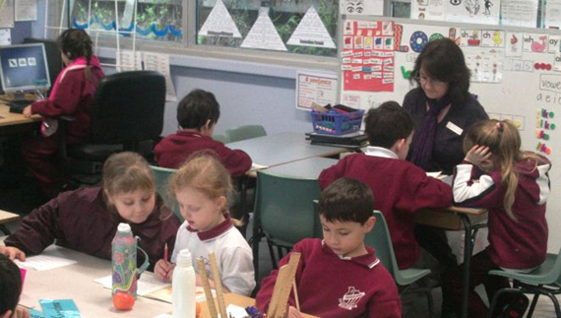
How will the assessment be done?
Classroom teachers will observe and record your child’s responses
Tasks will be completed individually
Notes:
To begin, teachers ask children to participate in an assessment (not a test) to work out where they are on their learning journey.
Teachers ask a series of questions to gather information about children’s initial literacy and mathematical knowledge.
Teachers are going to look at whether your child can hold a book correctly and engage in a story OR how your child is counting and strategies they use to help.... Perhaps they might use fingers as they count.
This important information supports teachers in meeting children’s individual learning needs. It is also used to provide parents and caregivers with feedback on what their child can do and how they can best support their child’s learning. This information is then used to assist teachers to monitor children’s learning.
All Kindergarten children undertake Best Start. Your child will be given a date and timeslot to come to their assessment in the first week. They will then start altogether on the Monday.

Slide 13
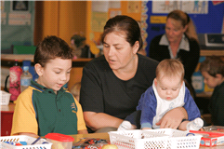
What information do parents receive?
Feedback to parents is provided.
Parents and carers receive clear,
accessible feedback on:
their child’s learning at school entry
the next steps in the learning process
how to support their child’s learning

Slide 14
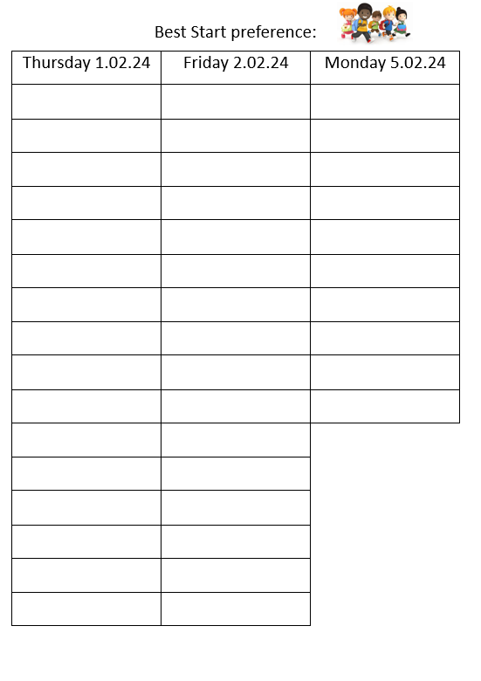
How to book in for your Best Start Assessment
In a few weeks you will receive your child’s Best Start time and what time they are starting on their first day. We stagger our times the first day so that we can greet and settle the children.

Slide 15
GAMES AND IDEAS
Play I spy: using sounds of letters.
Cook and make things with your child so they are learning about instructions, following sequences and you all enjoy the end product!
Ask your child to finger spell and sound out any words they are trying to write.
Use a digital camera and take photos of your child’s daily routine. Write a caption for the photos together for your child to read. Use these as a visual timetable of daily events, stories etc.
Notes:
Ask your child to dictate a sentence. You write it and cut each word up. Then your child needs to reorder the sentence.
Choose a ‘word’ of the week- something they don’t know the meaning of. Look in the dictionary, on the computer, find out what it means and make a list of words we now know!

Slide 16
Play who am I? Using descriptive words.
Sing songs and nursery rhymes!
Read number plates…Make up silly sentences with the letters

Slide 17
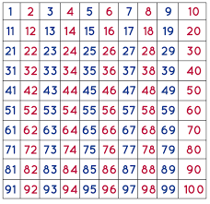
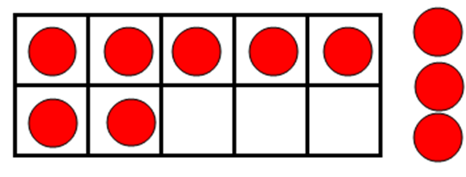
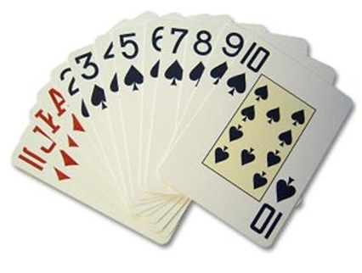
Maths Resources
Counters
Dice
Popsticks
Hundreds chart
Ten Frames
Number cards:
Playing cards
Numeral cards
Dominoes
Empty Number line
Notes:
In the classroom we use lots of hands on materials to engage students in mathematics!
Kids will probably come home and say all we did was play games in maths. That is good because we want them to enjoy maths. But what the teacher also does is make sure the particular game they are playing matches what they need to learn next.
For example - 1 group might use a dotted dice, 1 a 6-sided dice and 1 group a 9-sided dice for the same game.

Slide 18
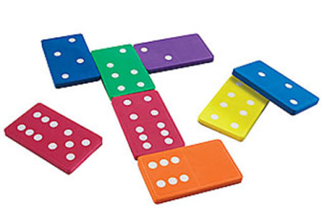
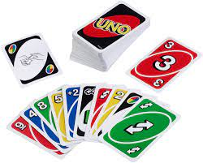
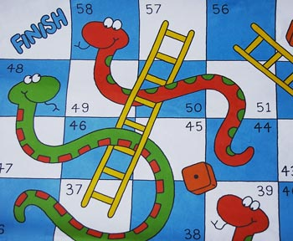
Things to do at home
Play with dice, cards & dominoes
Talk about shapes and objects you see
Sing Nursery Rhymes
Washing (sorting sizes & colours)
Play uno, monopoly and snakes & ladders
Go on a number search
Make sure they are forming their numerals correctly

Slide 19
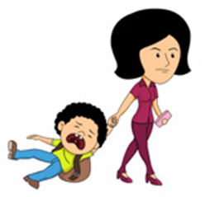
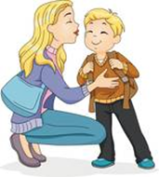
Now they Have Started
Always leave your child with a smile. A quick ‘I love you’ goes a long way when you are little and starting school. If you have conflict in the morning and you leave your child cranky and upset, they will worry and ultimately you will think about it during the day. Six hours can be a long time when you are little and think that mummy or daddy are cranky and you are in trouble.
Always be on time to pick up your child. Yours is the face they want to see the most at the end of the day. If you can’t be there, arrange for someone who can.
Display their most prized work on the fridge or anywhere else. (this includes EVERYTHING) you could sent it to relatives to share.

Slide 20
Now they Have Started
If you have trouble getting your child to school, talk to their teacher. They have lots of good ideas.
Write important dates and events on the calendar, such as library, sports day, special event days.
Pack food and drinks that you know your child eats. Listen to what your child wants to eat, within reason, and try to pack healthy yummy food. This will encourage empty lunchboxes at the end of the day. You can always pack little notes in their lunchbox to say special things.

Slide 21
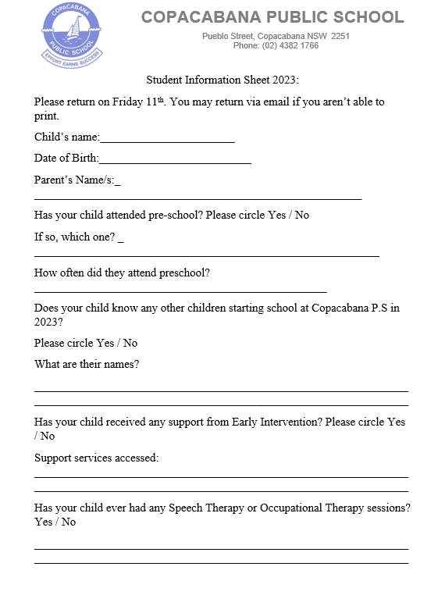

Slide 22
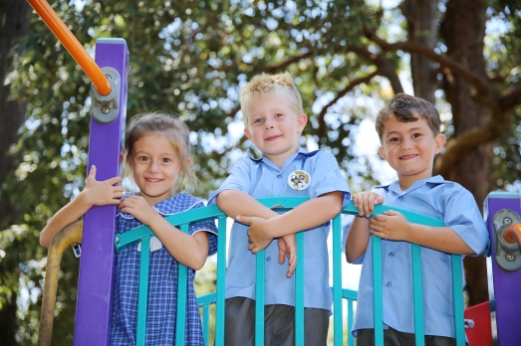
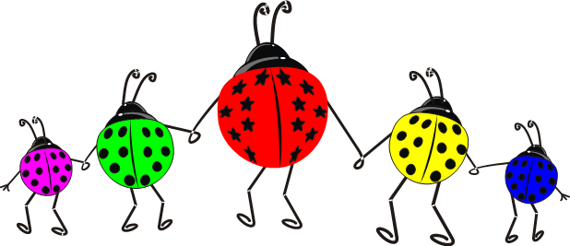
Copacabana PS Social Story
This is a story about starting school – Copacabana Public School.
There will be lots of children in your class and you will have your own special teacher and classroom.
Notes:
Please read the social story to your child and re-visit it often. It will give you ideas on what to discuss with your child.

Slide 23
Notes:
Please read the social story to your child and re-visit it often. It will give you ideas on what to discuss with your child.

